Slide 1
OSM 419 – Operations Strategy
Operations Strategy
Concept and Framework

Slide 2
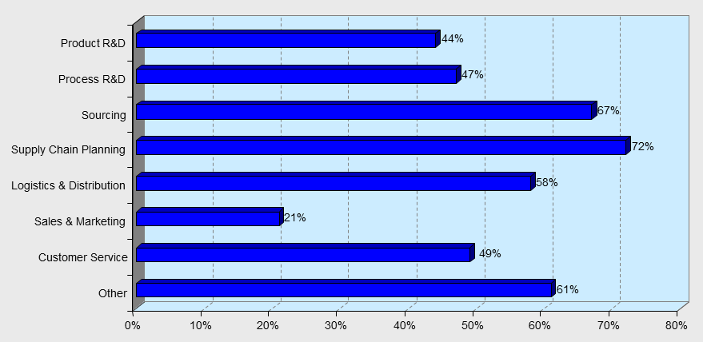
What do operations leaders do?

Slide 3
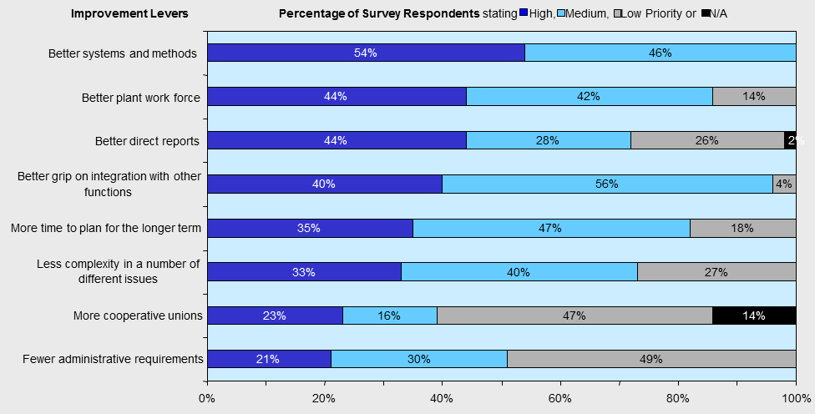
How do operations leaders create value?

Slide 4
Goals of this course
By the end of this course you should be able to:
1. Formulate an operations strategy
2. Understand the key elements and decisions
3. Analyze, value and optimize an operations strategy
4. Analyze key drivers/decisions for each element in an operations strategy
5. Evaluate them qualitatively and quantitatively
6. Develop recommendations and implementation plans

Slide 5
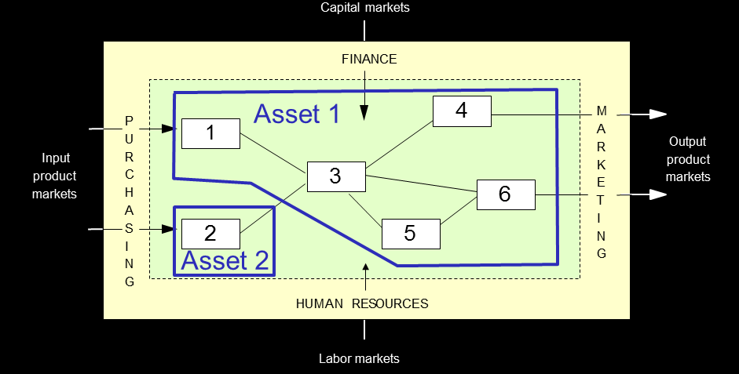
Operating System =
Assets + Processes

Slide 6
Operating System =
Assets + Processes
Perspectives on operations strategy:
  1. Capability view
  2. Resource based view
  3. Process view

Slide 7
Operations Management
The systematic design, direction, and control of processes that transform inputs into services and products for internals, as well as external, customers
Processes can be linked together to form a supply chain – interrelated processes within a firm and across different firms that produce a service or product to the satisfaction of the customers

Slide 8
Across the Organization
Finance
Acquires financial resources and capital for inputs
Material & Service Inputs
Sales Revenue
Support Functions
Accounting
Information Systems
Human Resources
Engineering
Operations
Translates materials and service into outputs
Marketing
Generates sales of outputs
Product & Service Outputs

Slide 9
Operations - Processes
External environment
Internal and external customers
Inputs
Workers
Managers
Equipment
Facilities
Materials
Land
Energy
Outputs
Goods
Services
Processes and operations
1
3
5
2
4
Information on performance

Slide 10
Operations - Processes
More like a manufacturing process
More like a service process
Physical, durable output
Output can be inventoried
Low customer contact
Long response time
Capital intensive
Quality easily measured
Intangible, perishable output
Output cannot be inventoried
High customer contact
Short response time
Labor intensive
Quality not easily measured

Slide 11



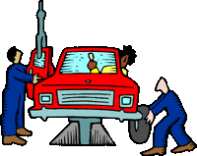

Goods and Services
Automobile
Computer
Installed carpeting
Fast-food meal
Restaurant meal/auto repair
Hospital care
Advertising agency/
investment management
Consulting service/
teaching
Counseling
100% 75 50 25 0 25 50 75 100%
| | | | | | | | |
Percent of Product that is a Good Percent of Product that is a Service

Slide 12
The Supply Chain
Core processes are sets of activities that deliver value to external customers
  Supplier relationship process
  New service/product development process
  Order fulfillment process
  Customer relationship process
Support processes provide vital resources and inputs to the core processes

Slide 13
Support Processes
EXAMPLES OF SUPPORT PROCESSES
Capital acquisition | The provision of financial resources for the organization to do its work and to execute its strategy
Budgeting | The process of deciding how funds will be allocated over a period of time
Recruitment and hiring | The acquisition of people to do the work of the organization
Evaluation and compensation | The assessment and payment of people for the work and value they provide to the company
Human resource support and development | The preparation of people for their current jobs and future skills and knowledge needs
Regulatory compliance | The processes that ensure that the company is meeting all laws and legal obligations
Information systems | The movement and processing of data and information to expedite business operations and decisions
Enterprise and functional management | The systems and activities that provide strategic direction and ensure effective execution of the work of the business

Slide 14
What is strategy?
Strategic thinking has its roots in military strategy
  “The branch of military science dealing with military command and the planning and conduct of a war.”
And has evolved to focus on business
  “An elaborate and systematic plan of action.”

Slide 15
Operations Strategy
Specifies the means by which operations implements corporate strategy and helps build a customer-driven firm
  Customer value proposition: a clearly articulated set of benefits that the firm offers to its customers.
Corporate strategy provides an overall direction that serves as the framework for carrying out all the organization's functions

Slide 16
Corporate Strategy
Environmental scanning
Developing core competencies
  Workforce
  Facilities
  Market and financial know-how
  Systems and technologies
Developing core processes
Global strategies

Slide 17
Market Analysis
Market segmentation
Needs assessment
  Service or product needs
  Delivery system needs
  Volume needs
  Other needs

Slide 18
Competitive Priorities
DEFINITIONS, PROCESS CONSIDERATIONS, AND EXAMPLES OF COMPETITIVE PRIORITIES
COST | Definition | Process Considerations | Example
Low-cost operations | Delivering a service or a product at the lowest possible cost | Processes must be designed and operated to make them efficient | Costco
QUALITY
Top quality | Delivering an outstanding service or product | May require a high level of customer contact and may require superior product features | Ferrari
Consistent quality | Producing services or products that meet design specifications on a consistent basis | Processes designed and monitored to reduce errors and prevent defects | McDonald’s
TIME
Delivery speed | Quickly filling a customer’s order | Design processes to reduce lead time | Dell
On-time delivery | Meeting delivery-time promises | Planning processes to increase percent of customer orders shipped when promised | United Parcel Service (UPS)
Development speed | Quickly introducing a new science or a product | Cross-functional integration and involvement of critical external suppliers | Johnson & Johnson

Slide 19
Competitive Priorities
DEFINITIONS, PROCESS CONSIDERATIONS, AND EXAMPLES OF COMPETITIVE PRIORITIES
FLEXIBILITY | Definition | Process Considerations | Example
Customization | Satisfying the unique needs of each customer by changing service or products designs | Low volume, close customer contact, and easily reconfigured | Ritz Carlton
Variety | Handling a wide assortment of services or products efficiently | Capable of larger volumes than processes supporting customization | Amazon.com
Volume flexibility | Accelerating or decelerating the rate of production of service or products quickly to handle large fluctuations in demand | Processes must be designed for excess capacity | The United States Postal Service (USPS)

Slide 20
Order Winners and Qualifiers
Order Winner
Sales ($)
Order Qualifier
Low
High
Sales ($)
Achievement of competitive priority
Low
Threshold
High
Achievement of competitive priority

Slide 21
Operations Strategy Framework: VCAP
V = C x (A + P)
V = Value
C = Capabilities
A = Assets
P = Processes

Slide 22
The goal of strategy:
Value maximization
The goal:
maximize the net present value of the organization
Assess – assets, processes, capabilities to achieve the goal

Slide 23
The principle of alignment: Strategic fit
Operations strategy should develop assets and configure processes such that the resulting capabilities are aligned with the competitive position that a firm seeks over time.

Slide 24
Formulation of Operations Strategy
Questions to be addressed:
What must operations do particularly well?
For each targeted customer segment, how should the operations capabilities be prioritized around cost, flow time, quality, and flexibility? How is the organization doing along each one of these dimensions?
How do we configure our processes, i.e. the network of activities, to support these capabilities?
The answers lead to a tailored operating system: its assets and processes are configured such that its capabilities best fit the customer value proposition specified by the competitive strategy.

Slide 25
The Capabilities View of Operations
Capabilities determine the dimensions along which the operating system excels.
  Management consulting firm: provides high quality customized advice.
  McDonalds: delivers inexpensive food quickly, from a standard and limited menu with a well-defined quality level.
  Zara: delivers a large selection of new designs at a reasonable cost.

Slide 26
The Capabilities View of Operations
Given the current assets and processes the firm already acquired and configured, what capabilities does the operations function support?
( Current/Actual Capabilities)
Given the customers’ need and the competitive position of the firm, what does operations function of the firm need to excel in?
  (Desired Capabilities)

Slide 27
Current Capabilities
What is the total cost of operating, including variable and fixed costs? (Cost)
What is the total response or lead time? (Responsiveness)
What is the ability to deliver quality outputs? (Quality)
What is the operations’ flexibility to change inputs, activities, volumes, or outputs? (Flexibility)

Slide 28
Desired Capabilities
Which competitive position is that the firm desires to occupy?
  Operating system should be aligned with the competitive strategy of the firm
  Reconciliation of market requirements and operational resources and processes

Slide 29
The Resource View of Operations
Any organization is considered to be a bundle of real assets/resources (all the means needed to perform the activities excluding financial assets).
Real assets: tangible or intangible.
  Tangible assets: Human resources (people) and capital assets (property, plant and equipment).
  Intangible assets: Relationships with suppliers and customers, intellectual property, reputation and brands, knowledge, experience, technologies.

Slide 30
The Resource View of Operations
How many assets should we invest in? (Sizing)
When should we expand or shrink capacity? (Timing)
What kind of assets are best? Human or capital intensive? Specialized or flexible? (Type)
Where should assets be located? (Location)

Slide 31
Resource-Based View
Competitive advantage is derived from the firm’s development of unique bundles of resources and capabilities that are:
  Valuable: allow the firm to improve its market position relative to competitors
  Rare: in relatively short supply
  Inimitable: are difficult or costly to imitate or replicate
  Non-substitutable

Slide 32
Resource-Based View
Resource: an observable, but not necessarily tangible, asset that can be valued and traded
  e.g., brand, patent, parcel of land, license
  Asset or input to production than an organization owns, controls or has access to on a semi-permanent basis
Capability: not observable, and hence necessarily intangible, cannot be valued and changes hands only as part of an entire unit
  Processes, activities or functions performed within a system
  Utilize the organization's resources

Slide 33
Resource-Based View
Types of capabilities
  Process-based
    e.g., McDonald’s
  Systems- or coordination-based
    e.g., Ritz-Carlton
    e.g., Southwest Airlines
  Organization-based
    e.g., Nucor Steel
  Network-based
    e.g., Zara
    e.g., Dell

Slide 34
The Process View of Operations
The process view highlights how assets perform activities and add value, and how work flows in the organization.
Processes are structured, recurrent activities that transform inputs into outputs.
Value stream mapping to understand the operating system and improvement areas

Slide 35
The Process View of Operations
Which activities do we perform internally, which are outsourced, and how do we manage suppliers?
Which technologies do our processes need?
  -Coordination and information technology
  -Product technology
  -Process technology
  -Transportation and logistics technology
How do we match demand to available supply?
How and when do we improve and innovate?
How do we manage risk?

Slide 36
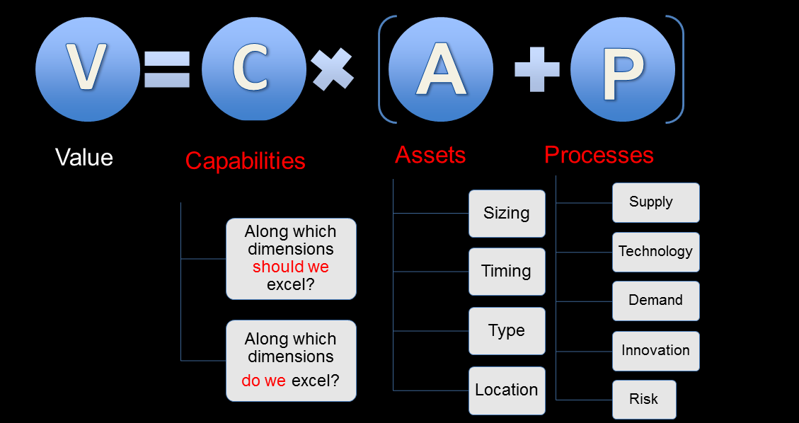
VCAP Framework

Slide 37
Operations Management and Operations Strategy
Operations management is
  more about controlling, managing, and improving operational (daily) repetitive economic activities
  often concerned with a individual process and given set of resources and products
Operations strategy is
  about choosing the asset bundle & processes and building future capabilities
  less about one process, more about the collectivity
  must specify all resources and processes in the value chain and plan for the future

Slide 38
Trends in Operations Management
Productivity improvement
Global competition
Ethical, workforce, and environmental issues
Increasing demand of faster, cheaper, and more efficient
Sharing economy

Slide 39







Changing Face of Markets

Slide 40
